Slide 1

Marketing Management - I Final Presentation
On
Sports Industry
Under the guidance of: Prof. Dhananjay Bapat
Presented by: Arpita Awasthi 20PGP033 | Dikshant Dahiya 20PGP127 |Harshit Gupta 20PGP075
Kevin Abraham Vazhayil 20PGP097 |Padhmaja K 20PGP138 |Piyush Soni 20PGP078
Sumit Shekhar 20PGP095

Slide 2

INTRODUCTION
INNOVATION
MICROFIBERS
NANOTECHNOLOGY
INSULATOR
POLYESTER
MARKET TREND
ATHLEISURE
SPORTS AFFILIATION
DISPOSABLE INCOME
MARKET SHARE
238 BILLION USD
DISTRIBUTION CHANNEL
RETAIL- 79%
ONLINE-21%
PRODUCT WISE
SHOES- 58%
APPAREL- 42%
MARKET SEGMENTATION
END USER- a) men - >50%
b) others

Slide 3


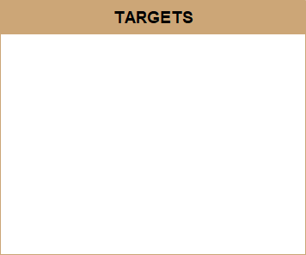
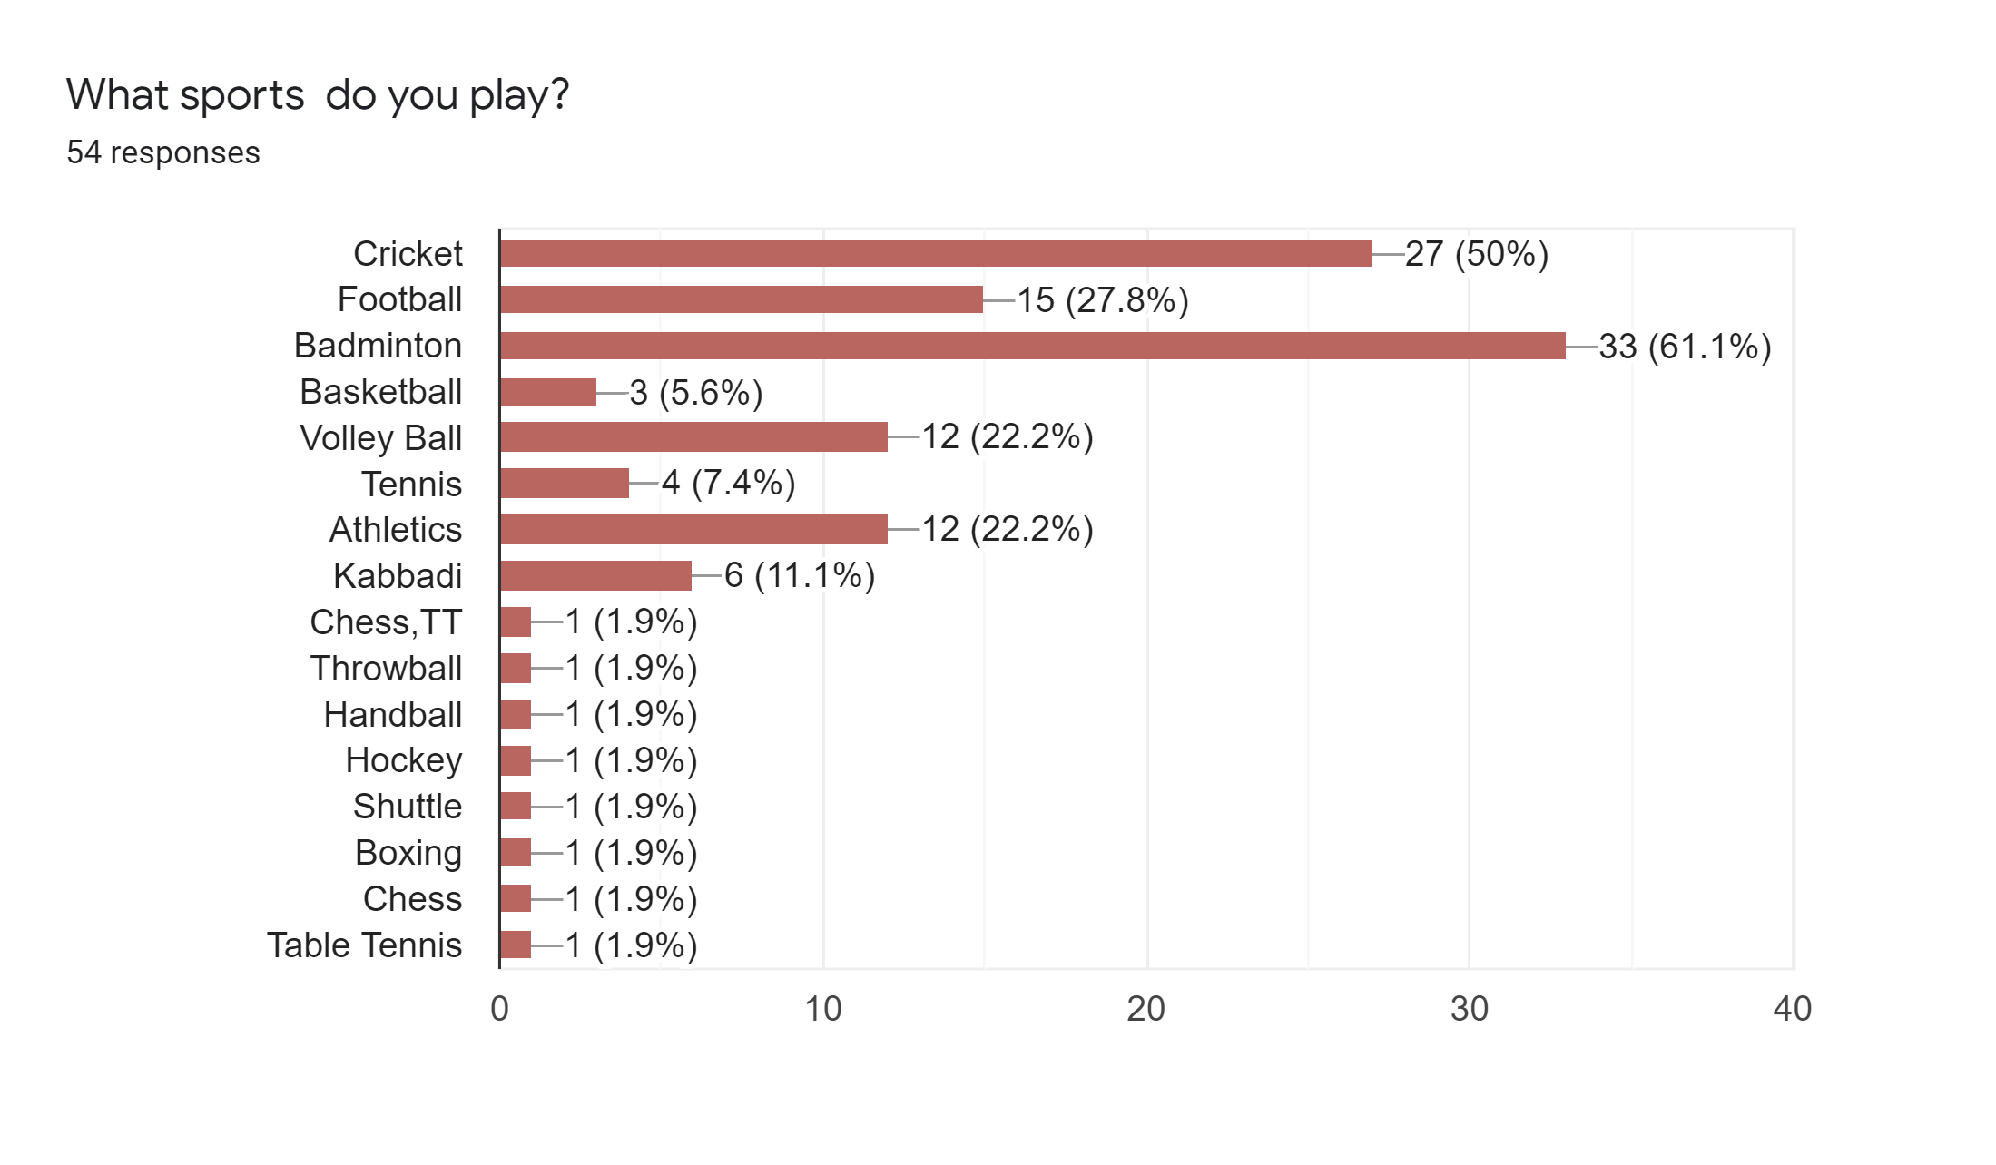
Young Children
Fitness enthusiasts
Professionals
Genx and Millenials
Older people
Sport Tourism
Sport goods
Sports Apparel
Amateur Participant Sports
Professional Sports
High School and college athletics
Outdoor Sports
Sports Marketing Firms
Sports Sponsorship[ Industries
Sports Governing bodies

Slide 4
Market Conditions related to Covid19 scenario
Pre Covid19 scenario
During Covid19 scenario
Post Covid19 strategy
Indian Sports Industry:
Major concentration on offline mode rather than digital mode
No promoters. Basically clubs and state team games did the promotions
Production according to Indian terrain.
Indian Sports Industry:
Both online and offline mode got disrupted. The need of people got reduced
No promotion. The usual method of club and game promotion won’t work since no viewers in online platform
Indian Sports Industry:
Companies like Nivia changed online platform and increased digital presence
The necessary for an omni channel approach on marketing and product placing
International Sports Industry
Both offline and online mode were active in promotion and selling
The brand loyalists continues to stay and the companies concentrate majorly on them only
International Sports Industry
The stopping of games and store lock down caused a disruption in advertisement.
Consumer spending reduced
International Sports Industry
Reopening stores and improving traffic for both online and offline
Going in omnichannel. Anticipating the consumer behaviour
Expecting aggressive movement

Slide 5
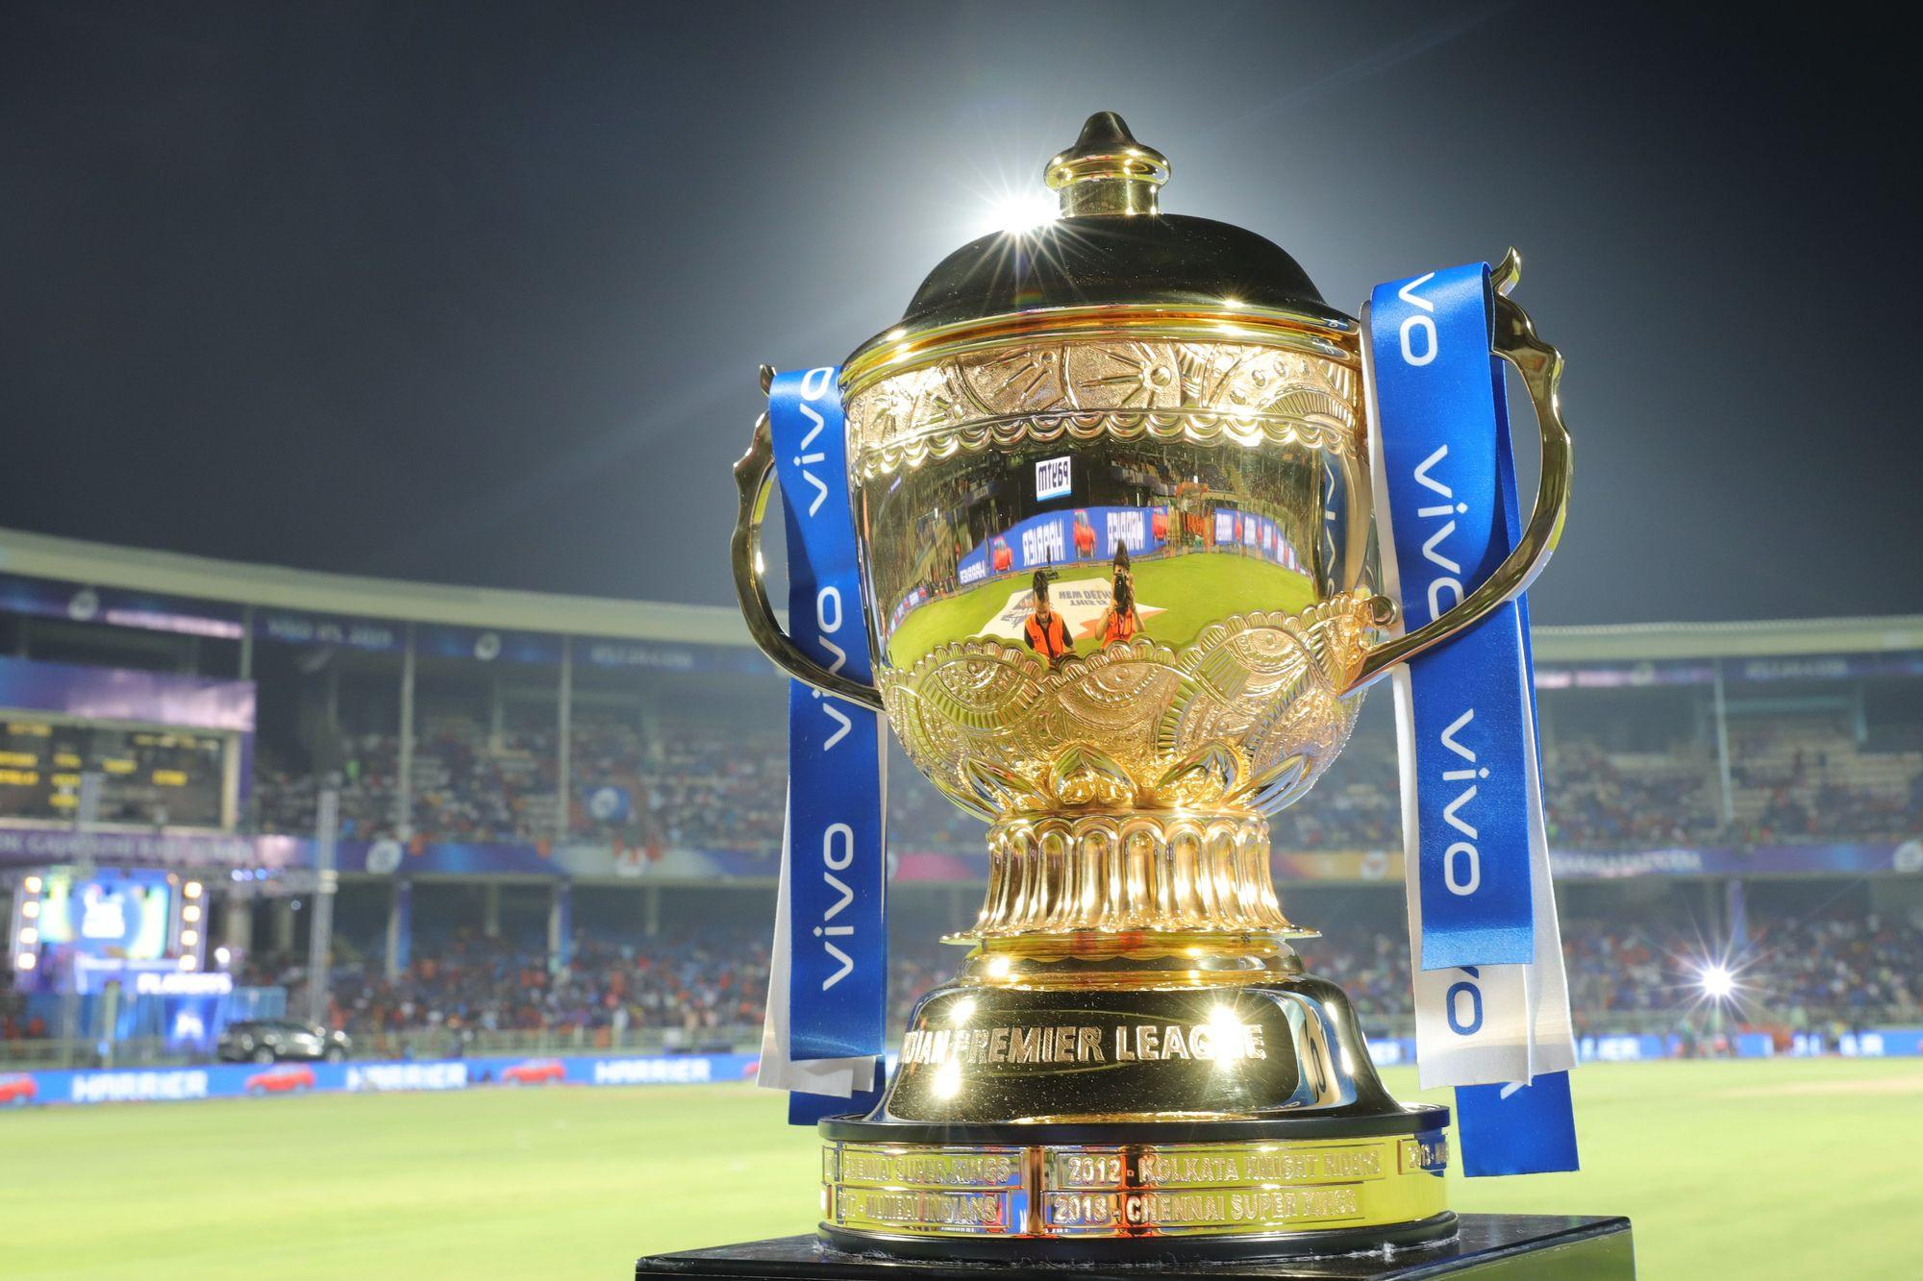
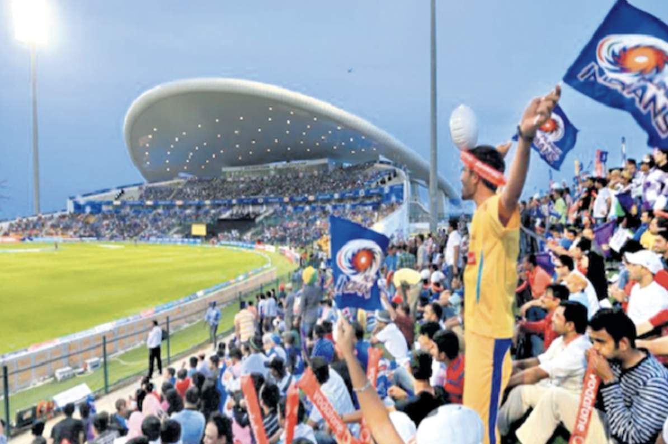
Distribution Channels & Marketing
Retail Outlet
E-marketplace
Direct Selling
Event based selling
Relationship Marketing: Devotion & loyalty - If Ronaldo wears it, And I’m his fan; then I’ll buy it.
Advertising: Nonpersonal, paid announcement by an identified sponsor - Used to reach large audiences and create brand awareness.
Personal connect: Personal connect can be tailored to the target customers’ interests and needs.
Atmospherics: Creating specific behavioral or emotional effect in the consumer - The experience of attending a sports event in favourite team’s jersey.
Licensing and Sponsorship: A business agreement between two parties based on reciprocity.
Online marketing: Endorsements and social media influencing.

Slide 6
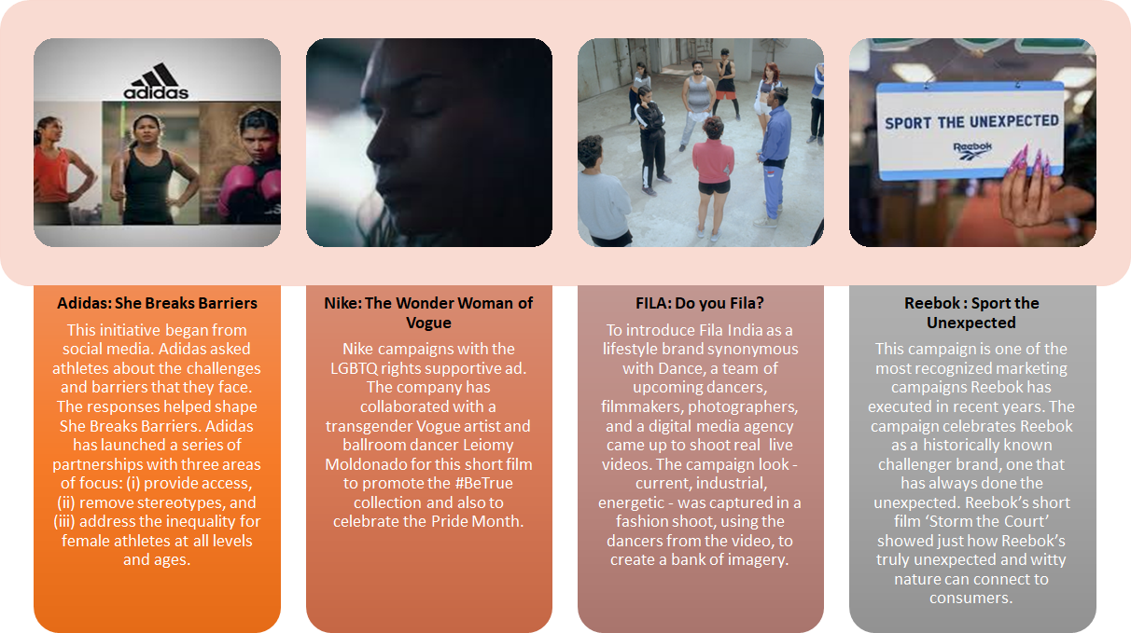
Campaigns for emotional Connect

Slide 7
THANK YOU !!

